Slide 1
Embedded Ethics:
Thinking about Stakeholders
Notes:
Script:
In this course, you have been developing your computer programming skills, and some day soon you’ll be putting your skills to work – maybe as a programmer for a software development company. Today we’re going to start thinking through some of the challenges you might face in your future work. Specifically, we’ll start answering two questions.

Slide 2
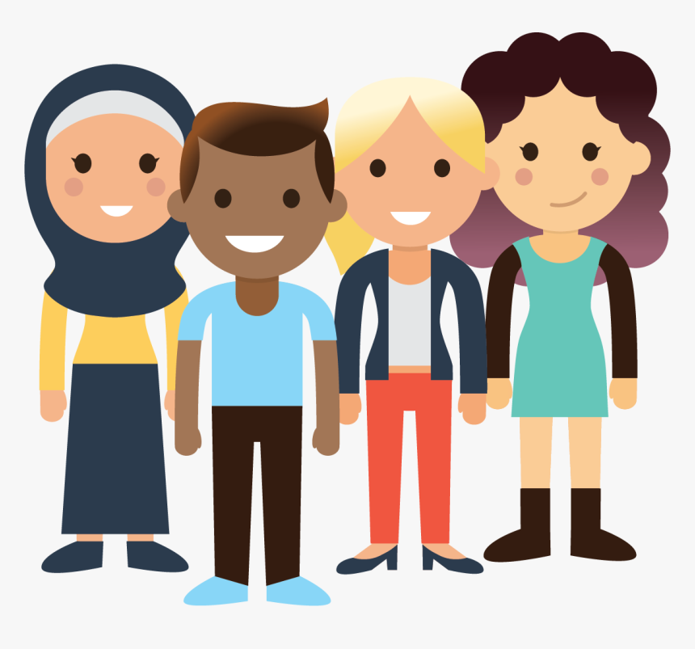
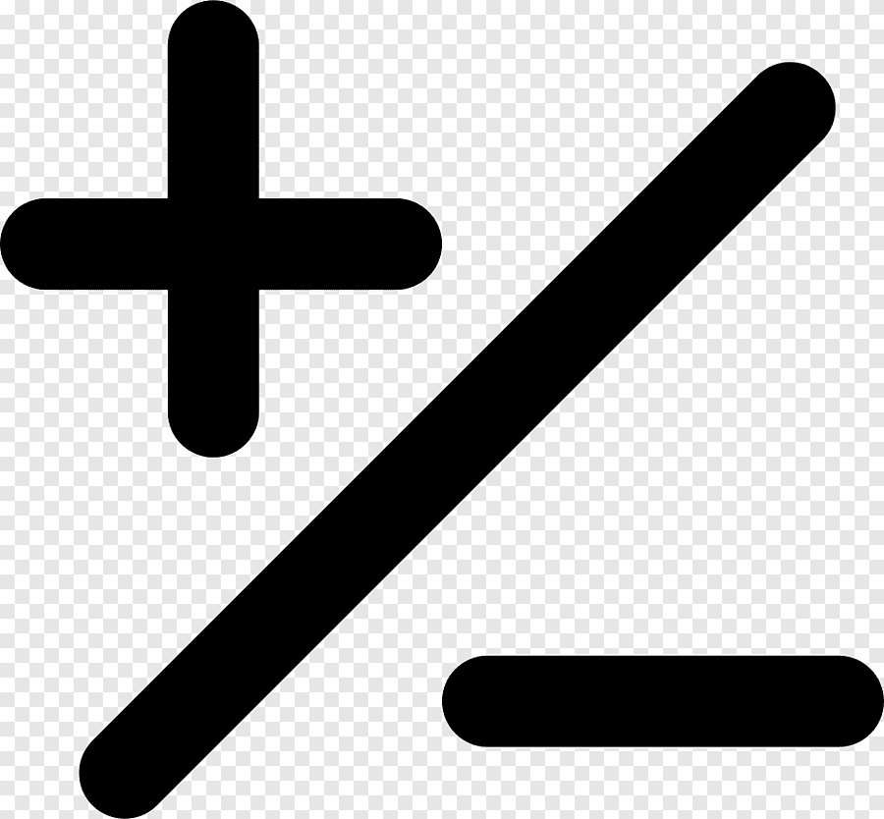
Image credit: Icon library (https://icon-library.com/png/975758.html)
Image credit:: Pinclipart (https://www.pinclipart.com/maxpin/ihmiwmh/)
Notes:
Source for image: Pinclipart (https://www.pinclipart.com/maxpin/ihmiwmh/)
Script:
(1) what groups of people might be affected by the decisions you make when you design an application, and (2) what kinds of negative and positive effects could these groups experience as a result of your design choices?

Slide 3
Stakeholder: Someone who will be affected by, and so has a “stake” in, a decision
Notes:
Script:
So first of all, what groups are we talking about? Who might be affected by design choices?
Let’s introduce the first piece of terminology. We’ll call anyone who might be affected by a decision a stakeholder in that decision. A stakeholder is anyone who has a stake, or interest, in the decision. So when computer programmers are designing applications, which groups are stakeholders in their decisions?

Slide 4
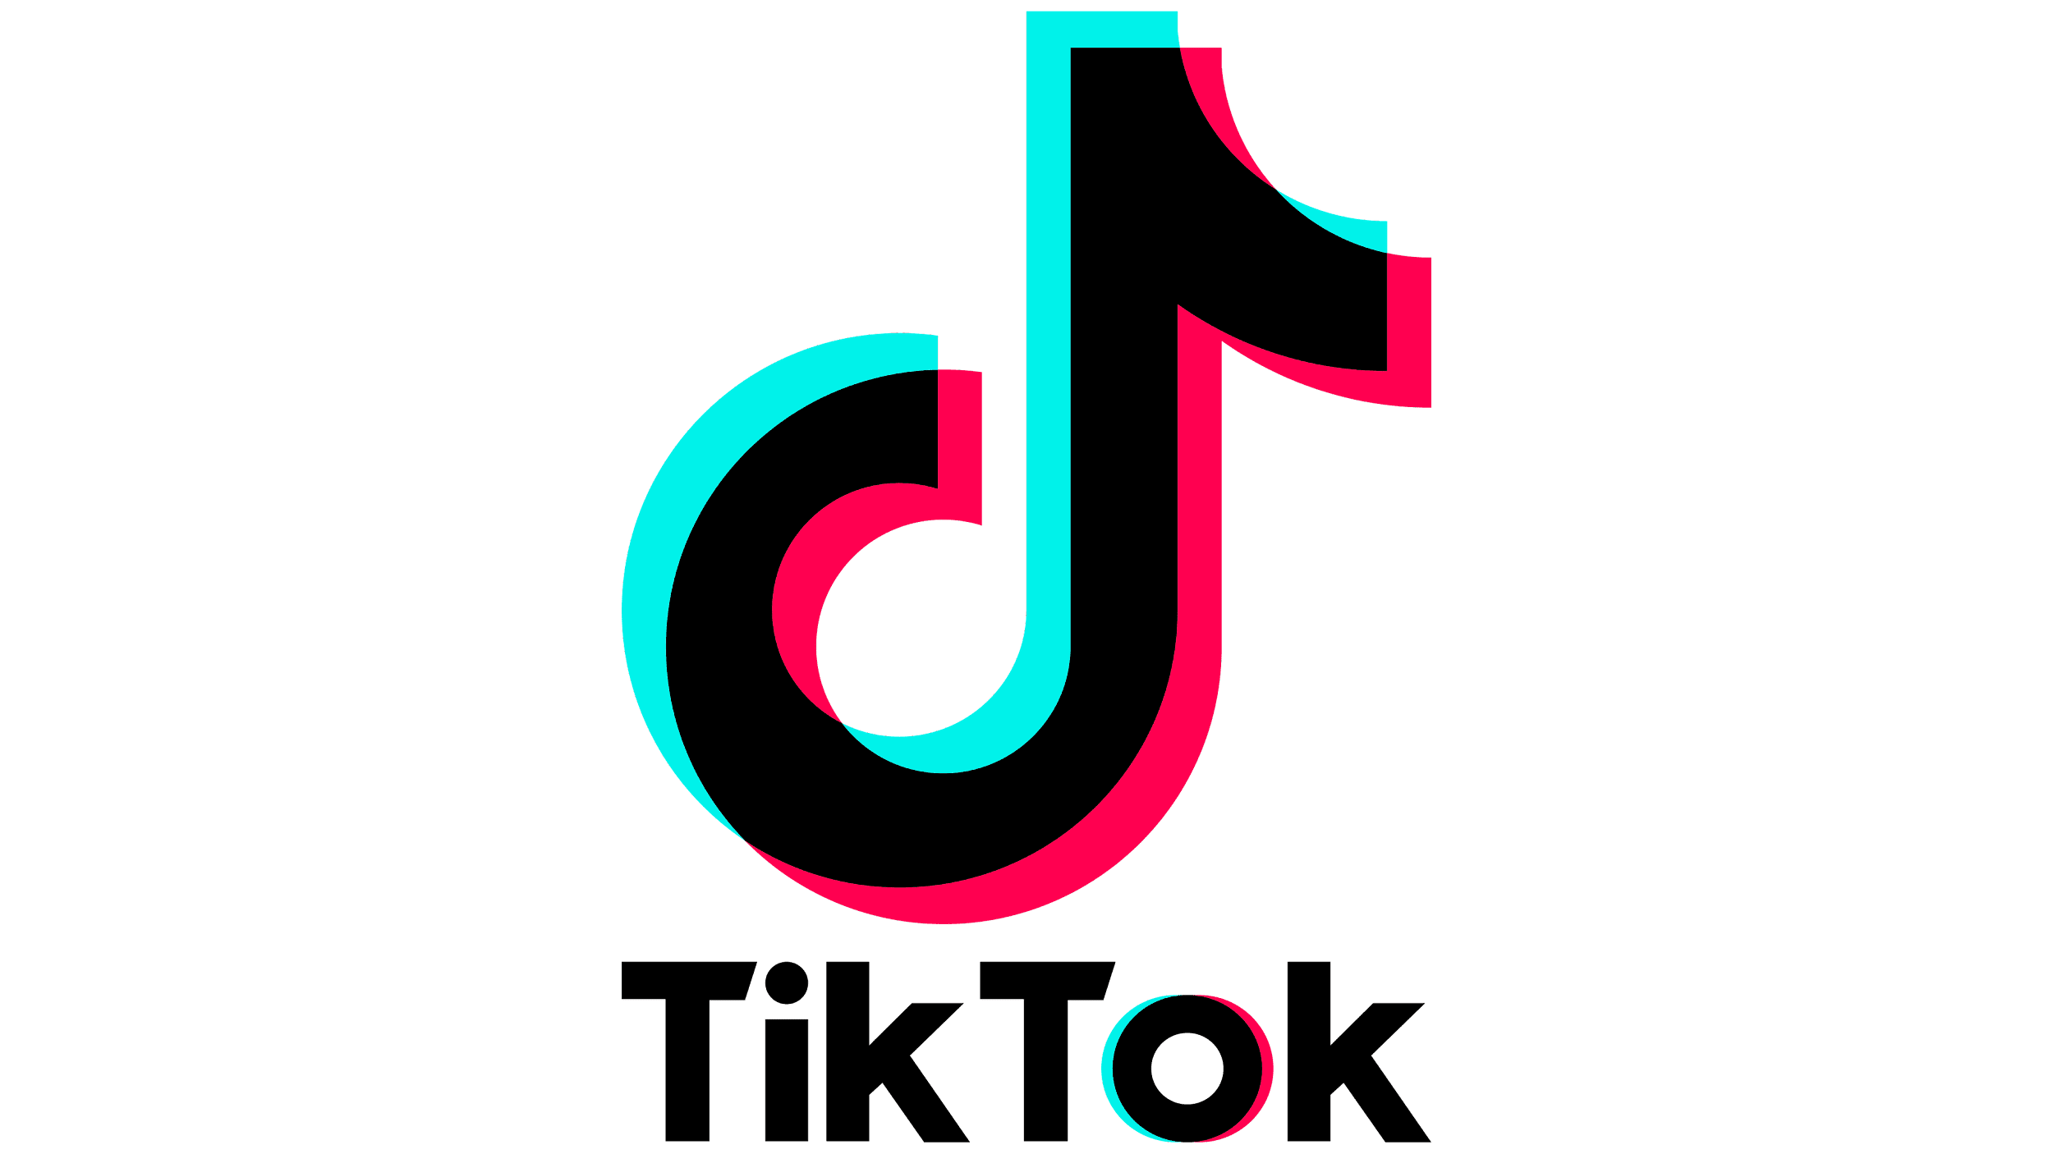
Image © ByteDance
Notes:
Script:
Lets go through an example: TikTok. I’m sure you’ve all heard of TikTok, but just in case, it’s a video-sharing application that doubles as a social media platform.

Slide 5
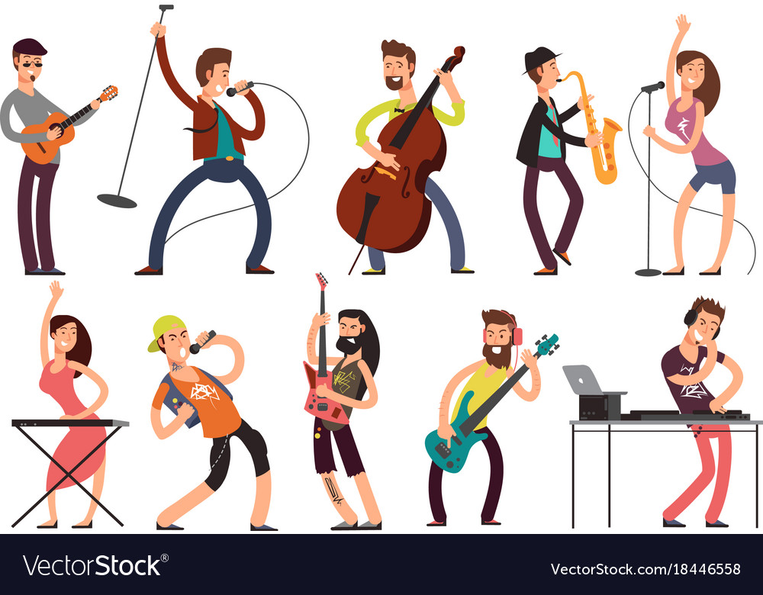
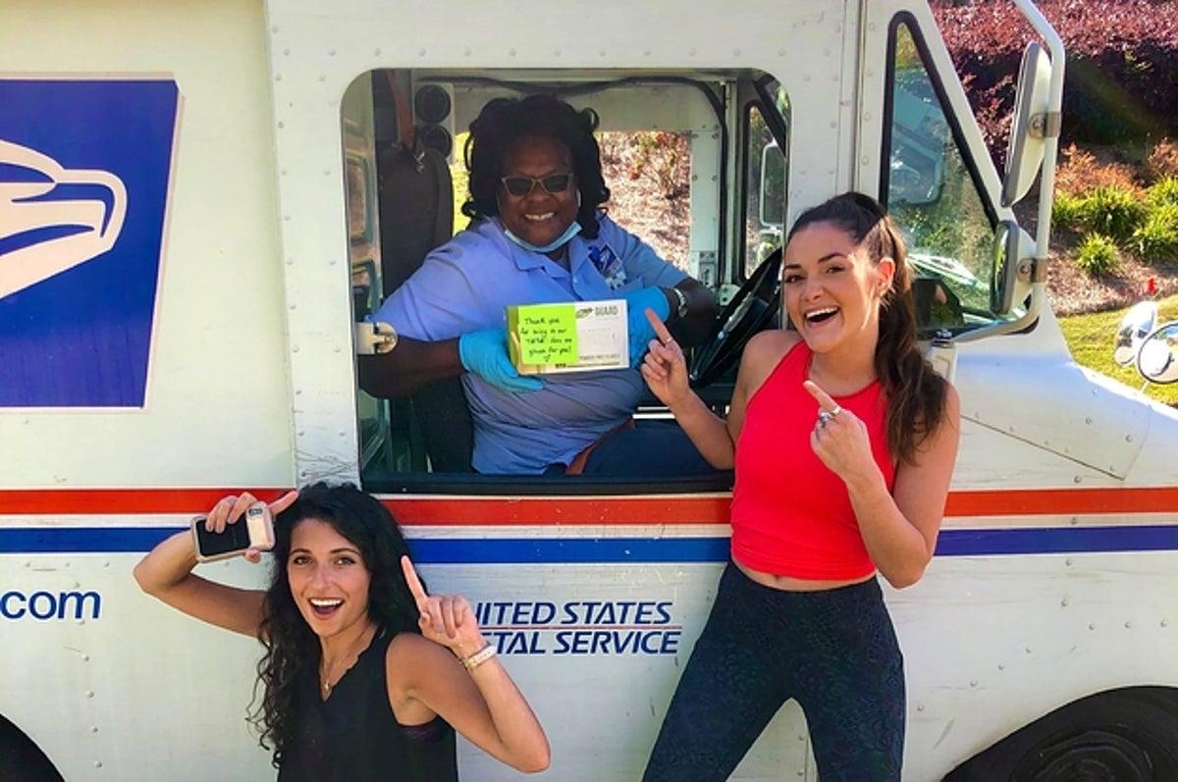
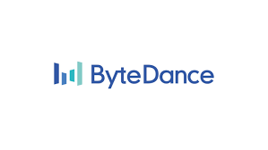
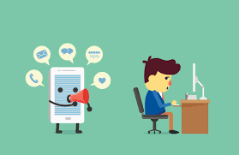
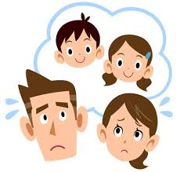
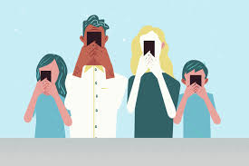
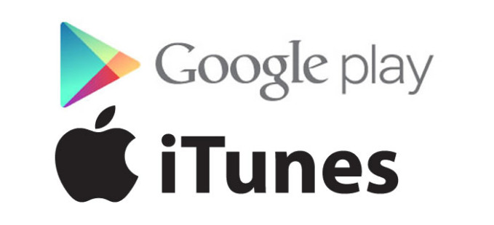
Image credits: Vectorstock (vectorstock.com/18446558), depositphotos (https://depositphotos.com/vector-images/distract.html), Istock photos (https://www.istockphoto.com/es/vector/preocuparse-por-los-ni%C3%B1os-de-parejas-gm1080074590-289481508) , Vectorstock (https://www.vectorstock.com/royalty-free-vector/people-with-phone-cartoon-young-people-vector-21146011), Buzzfeed news (https://www.buzzfeednews.com/article/laurenstrapagiel/mail-carrier-tiktok-photobomb), Shutterstock (https://www.shutterstock.com/image-photo/male-female-professionals-teamworking-during-brainstorming-1727882593), dreamstime (https://www.shutterstock.com/image-photo/male-female-professionals-teamworking-during-brainstorming-1727882593) , CTV news (https://www.ctvnews.ca/more/news-team-bios/lloyd-robertson-1.424649) © Alphabet, © apple, © ByteDance
Notes:
Script:
So some of the stakeholders in TikTok are obvious: The corporation, ByteDance, which created the application’ employees at that corporation; consumers who download and use the app; and distributors, like Google play and iTunes, who have an economic interest in the application. But there are also many other stakeholders in TikTok who might not be as obvious. For example, anyone who is in the background of a viral video that ends up on TikTok.
Consider this postal worker, who accidentally crashed a dance video, and ended up with millions of views on TikTok. She didn’t choose to download the application, so she is not a consumer, but she is still affected by the application – she is now internet famous.
Similarly, other people might be affected by the application, even without downloading the app themselves, because they know people who use it. For example, parents of TikTok users, teachers whose students use the application during class. And other groups might be affected in other ways. So we might think about artists, whose songs are used in TikTok videos; or media personalities and politicians who have to join TikTok to stay current; or environmental groups, who are affected by the cost of increased streaming and phone use.
All these groups are stakeholders. The programmers who created TikTok need to think about and anticipate the needs of all these different stakeholders who might be affected by the app, even if they are not directly involved in making or using the app.

Slide 6
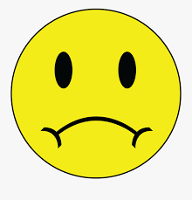
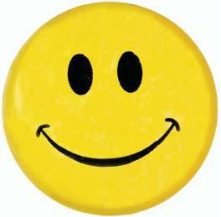
Notes:
Script:
Now that we’ve identified some stakeholders, we need to think about what kind of stake they have: how are their lives negatively or positively affected by the application.
Some stakeholders might just have a small stake in the programming decision. So the average user, like you or I, might just have to weigh the costs and benefits of watching entertaining videos vs possibly wasting time procrastinating. But some groups have bigger stakes, either positive or negative. For positive, we could think of TikTok influencers who gain employment because of their viral videos, while on the negative side, we could think about users who get bullied, or who become trapped because of conspiracy theories or scams spread on the social media platform.
To get even more exact about the different kinds of stakes that stakeholders might have, we need to introduce the final piece of vocabulary. All the examples I’ve used so far have been about well-being.

Slide 7
Wellbeing: All the different ways your life can go well or poorly
Violation of a Right: When someone is treated in a way they have a right not to be treated
Notes:
Script:
Your well-being is determined by looking at all the different ways your life can go well (money, entertainment, fame, happiness) or poorly (bullying, job loss, or proctrastination).
But some of the effects of an application can take a different form: a violation of a right. The rights that can be violated include privacy (the right to control how your personal information is shared and stored) and the right to fairness (the right to equal treatment and opportunity).
To get clearer about what it means to violate a right, let’s look at another example: ProctorU.

Slide 8
©ProctorU
Notes:
Script:
Again, you might have heard of them, but in case you haven’t, it’s an online examine service some universities have used to make sure students don’t cheat on remote-learning tests. A proctor uses the students’ webcams to monitor the students as they take their test.
Now one of the obvious stakeholders in ProctorU is the students, who are forced to use the exam-service in their classes. Students might worry that ProctorU violates their privacy, by allowing a stranger, the proctor, to see into their homes. The proctor may learn things about them by seeing their rooms, or they may even be able to tell where the student is located, by seeing the landmarks out the window. That’s a privacy violation: finding out a piece of private information they shouldn’t have access to.

Slide 9
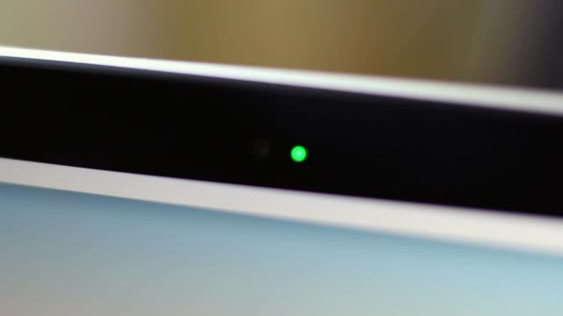
Image credit: iStock (https://www.istockphoto.com/videos/webcam-spy)
Notes:
Image: iStock (https://www.istockphoto.com/videos/webcam-spy)
Script:
Students might also worry that ProctorU violates their right to fair treatment.

Slide 10
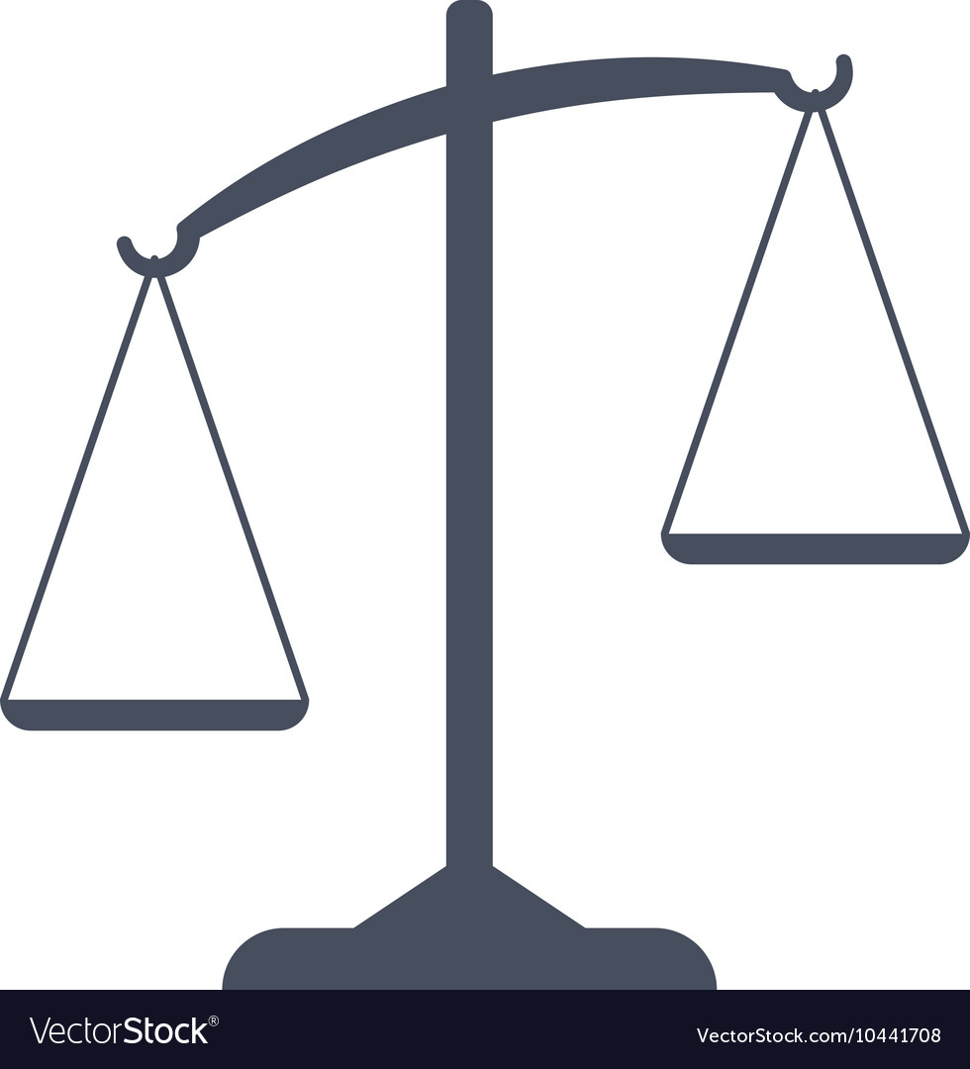
Notes:
Image: vector stock (https://www.vectorstock.com/royalty-free-vector/black-weighing-scale-vector-10441708)
Script:
ProctorU won’t anyone leave after they enter the online testing room, which may seem fair, unless you’re one of the students who lost internet connection during the exam and was not allowed to continue when their connection was restored. Students with good internet connections have access to the exam, while students who can’t afford reliable internet don’t have the same opportunity to succeed. That’s not fair.

Slide 11
Stakeholder: Someone who will be affected by, and so has a “stake” in, a decision
Wellbeing: All the different ways your life can go well or poorly
Violation of a Right: When someone is treated in a way they have a right not to be treated
Notes:
Script:
Now, much of the time, violating a right will also affect a person’s wellbeing. The students who are unfairly prevented from completing their tests, for instance, both had their right to fair treatment violated, and were made worse off.
But a right can be violated even a person’s well-being is not affected at all. Let’s imaging a student who has their privacy violated by the requirement to have their webcam on. Perhaps the proctor learns all sorts of information about the student against their wishes, but never uses that information to harm them in any way. This is a violation of that student’s right to privacy even if their wellbeing is never affected, indeed, even if they never learn that the invasion of privacy has occurred.
Now you can already see how complicated it can be to learn about all the stakeholders, and how they can be negatively or positively affected by the application. To recap, here is the vocabulary we have learned that will help you think through these issues. When you are making a design decision, you have to think about all the stakeholders – anyone who might be affected – and then notice what kind of stakes, or interests, they have in the decision. Ask yourself whether they have concerns about their wellbeing, like happiness or money, or the violation of their rights, like privacy or fairness, or all of the above.
Don’t worry if you’re still a little bit uncertain about how to consider all of these different stakeholders. You’ll be practising these skills further in the upcoming embedded ethics module. See you there!

